Slide 1
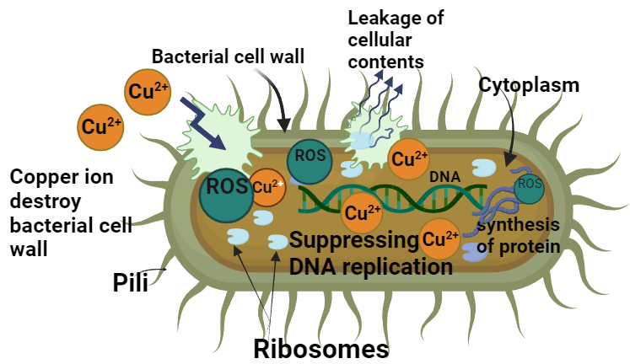

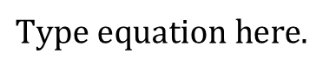
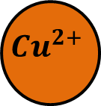
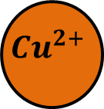


Moisture, acids,
Environmental Conditions
$${Cu}^{2+}$$
$${Cu}^{2+}$$
$${Cu}^{2+}$$
$${Cu}^{2+}$$
Copper containing materials

Slide 2
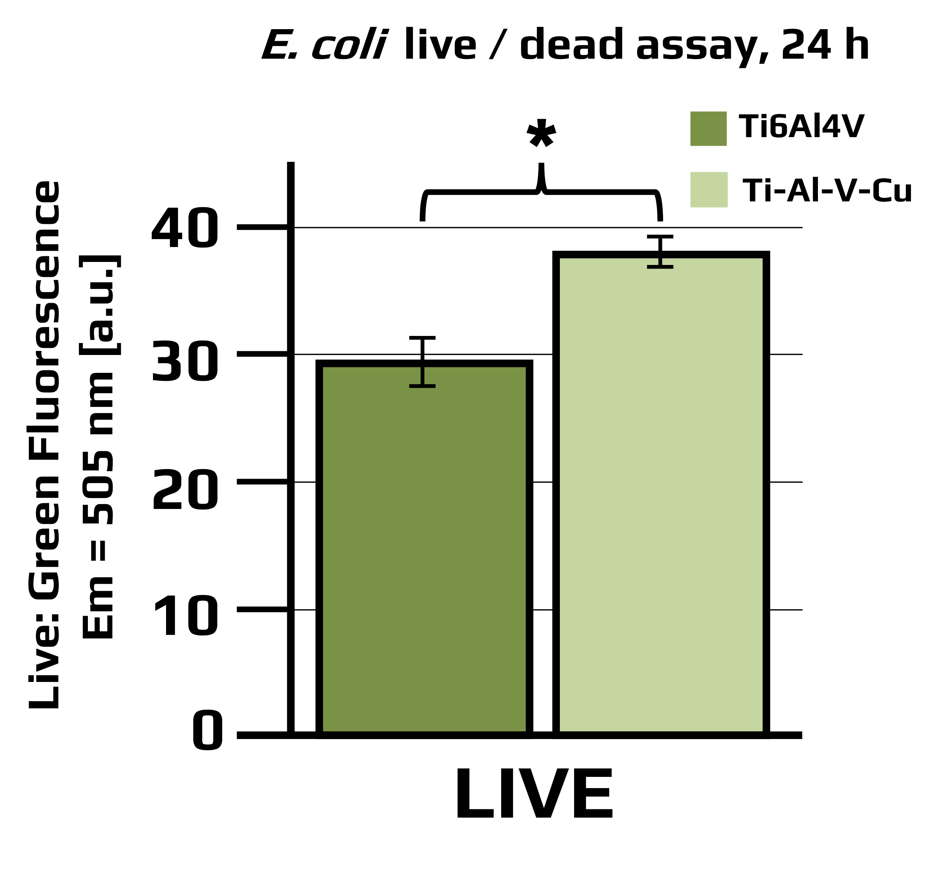
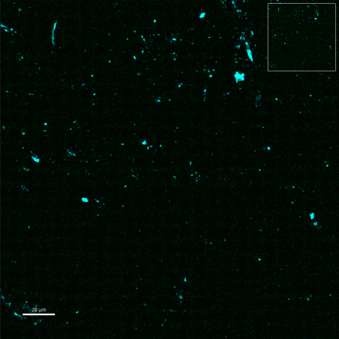
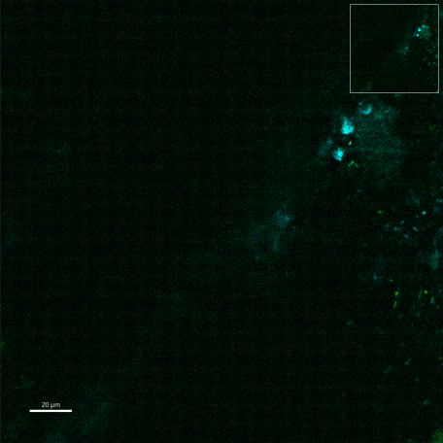
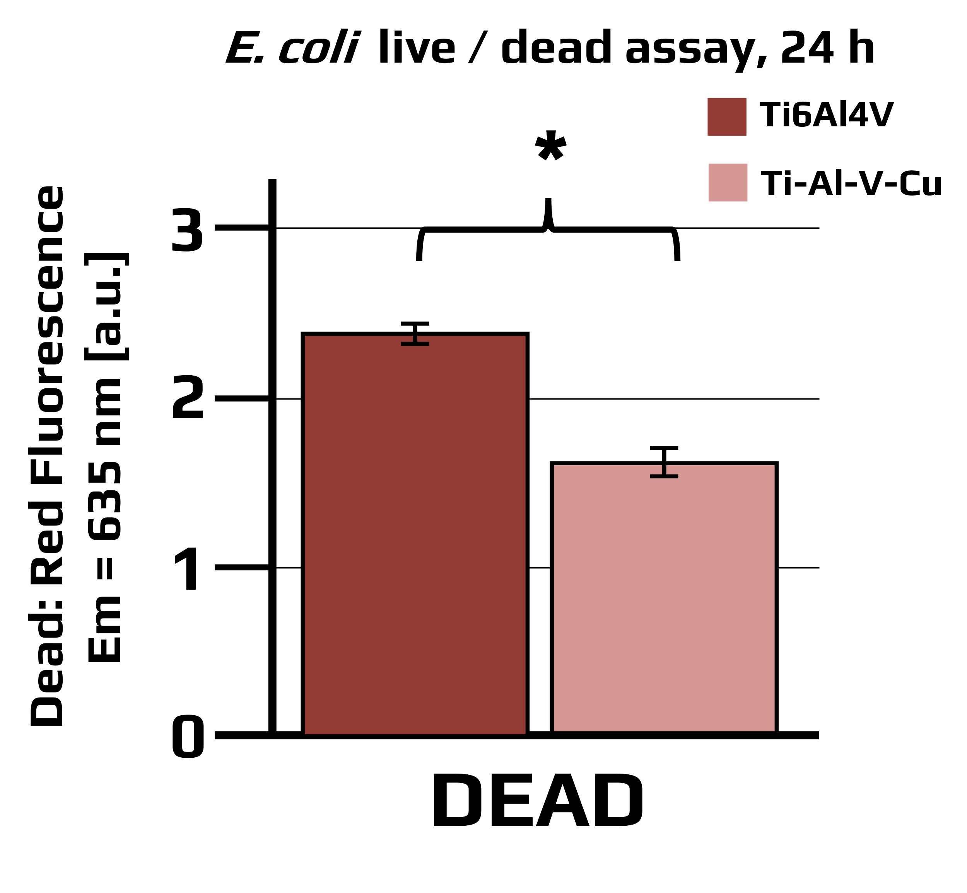
(a)
(c)
20 µm
(b)
(d)
20 µm

Slide 3
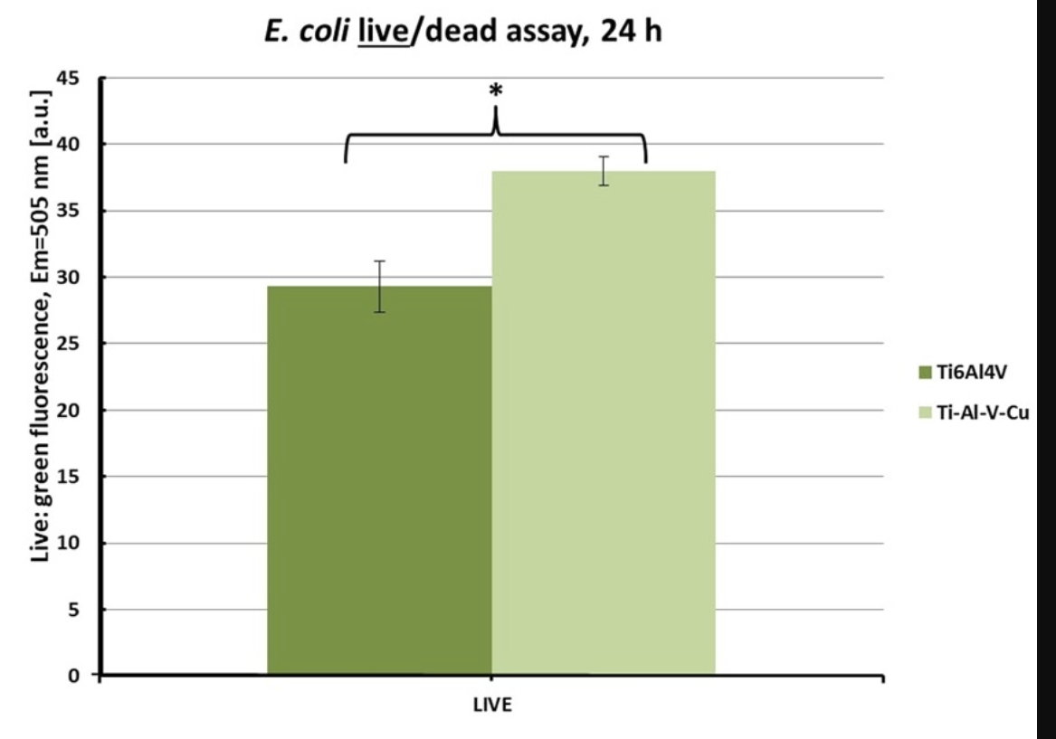
E. coli live / dead assay, 24 h
*
Ti6Al4V
40
Ti-Al-V-Cu
30
Live: Green Fluorescence
Em = 505 nm [a.u.]
20
10
0
LIVE

Slide 4
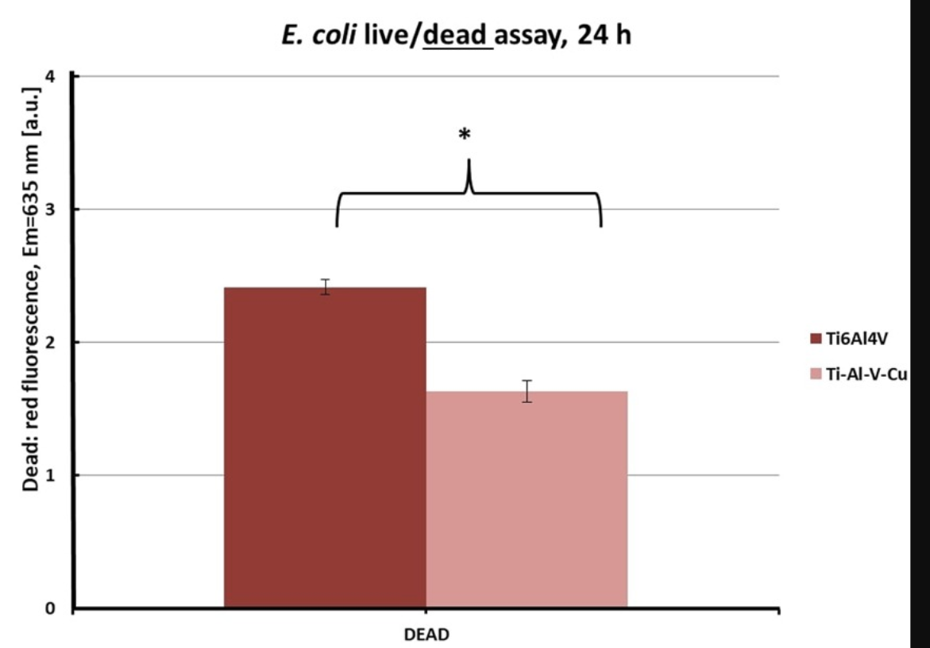
E. coli live / dead assay, 24 h
*
Ti6Al4V
Ti-Al-V-Cu
3
2
Dead: Red Fluorescence
Em = 635 nm [a.u.]
1
0
DEAD

Slide 5
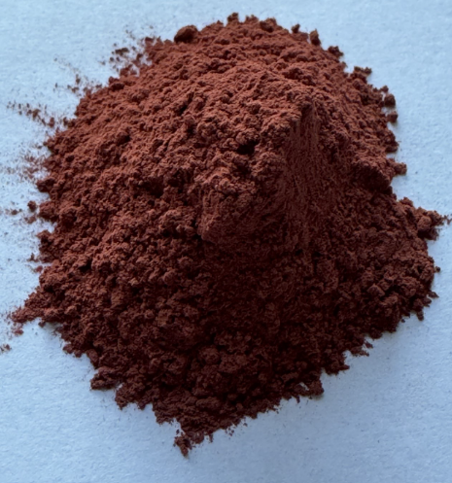
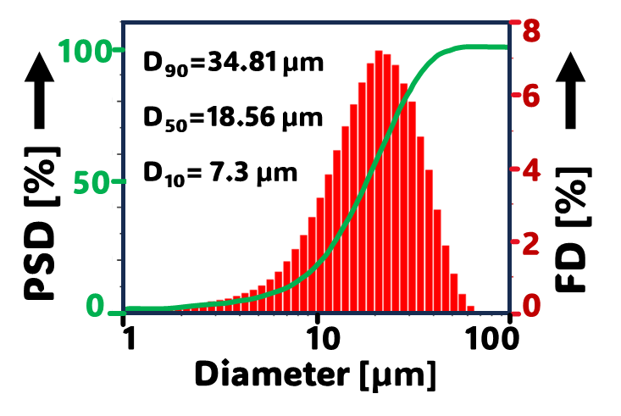
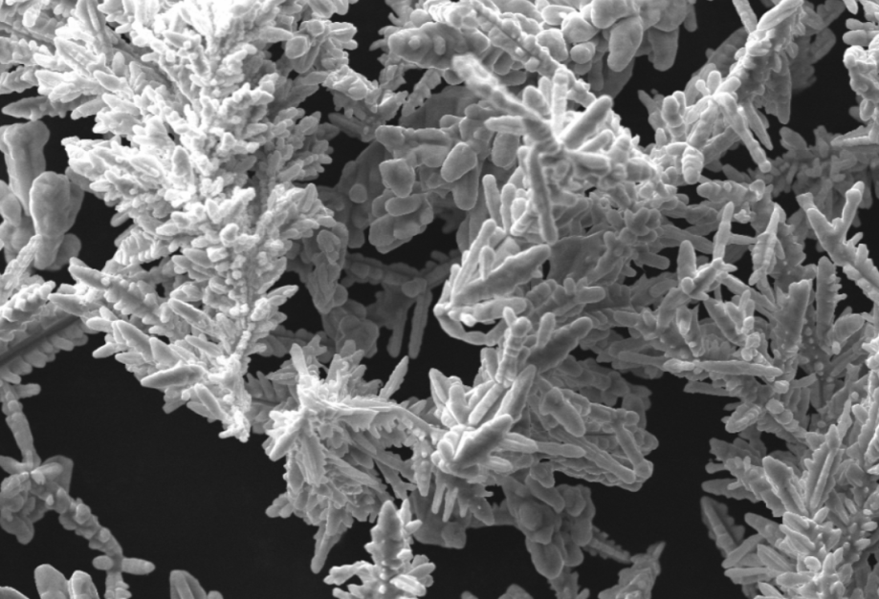
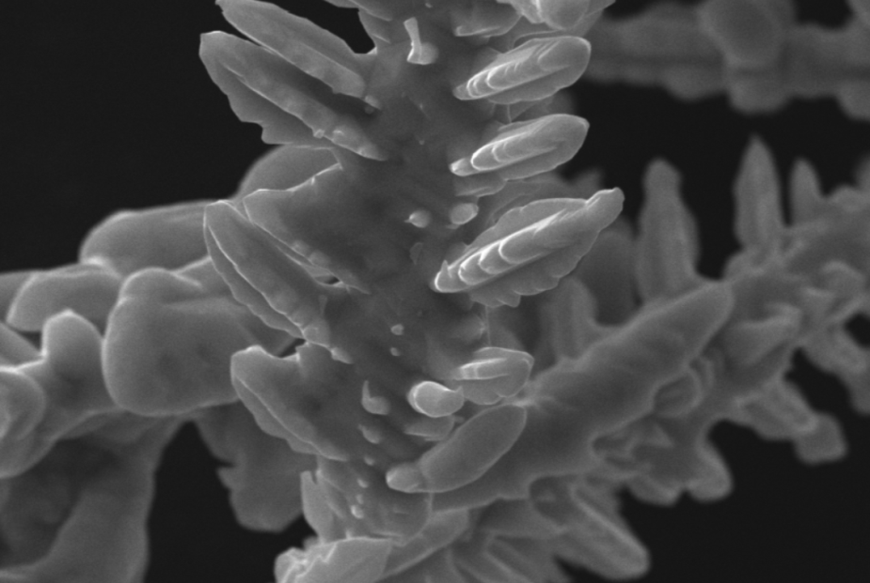
(a)
(b)
(c)
(d)
Dendritic structure
10 µm
1 µm

Slide 6
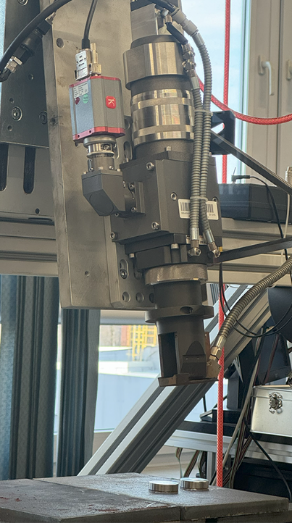
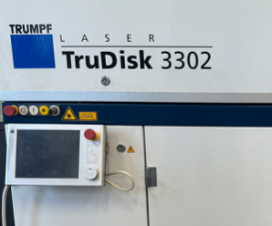
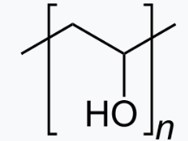
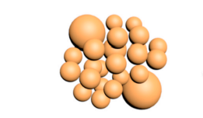
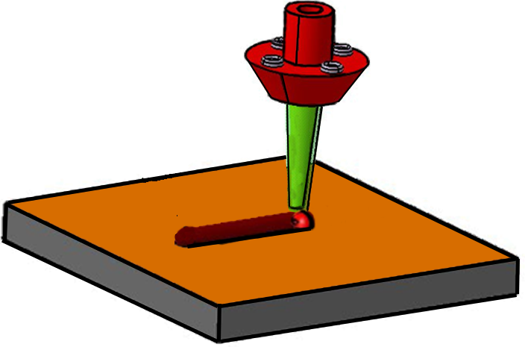
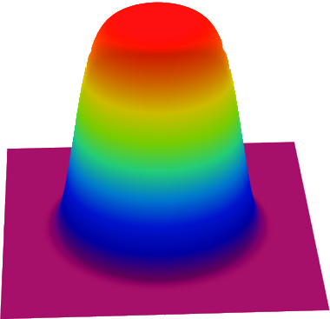

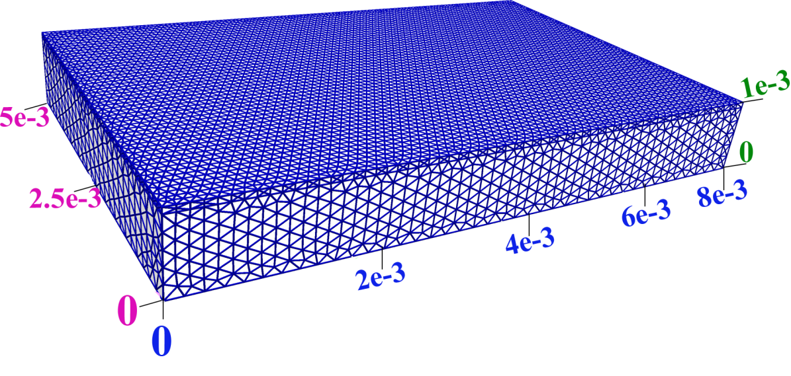
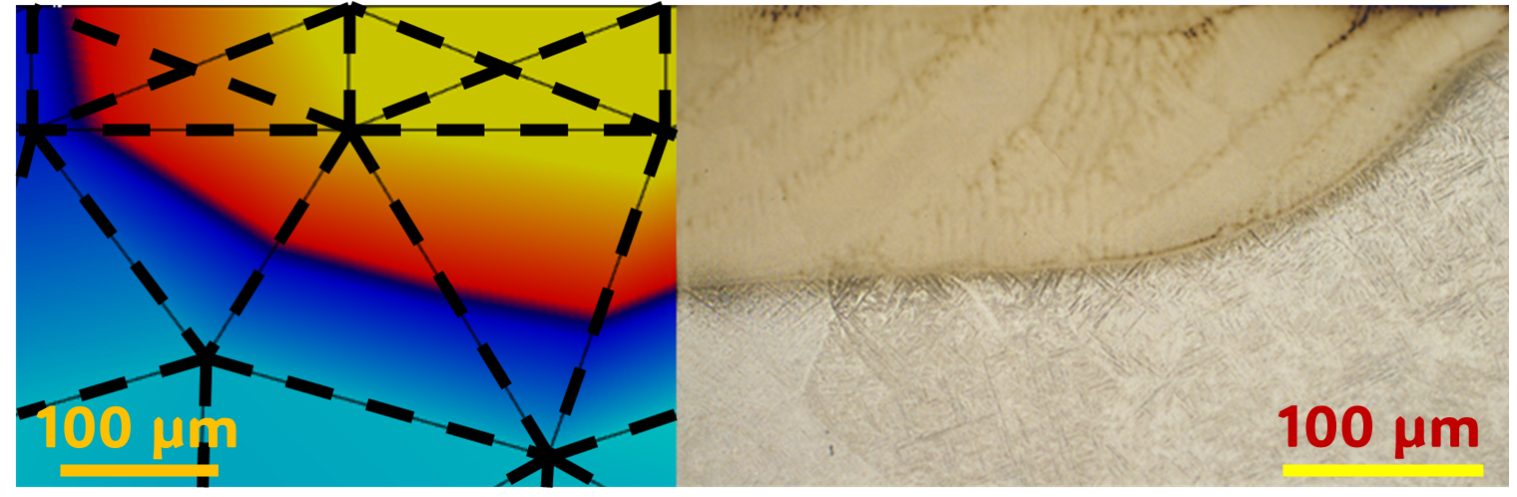
(a)
Control Panel
Samples
Laser Head
I_{max}=26.9 kW/mm²
+
micro-nano Cu particles
PVA
(b)
Slurry
spray coating
200 mm/s
(c)
(d)
Scan Direction
z
Ti6Al4V
x
y

Slide 7
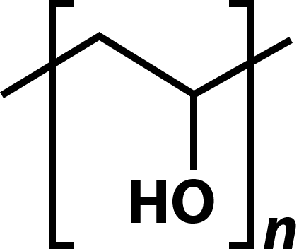
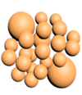
(a)
Control Panel
I_{max}=26.9 kW/mm²
Samples
Laser Head
(b)
+
micro-nano Cu particles
PVA
200 mm/s
Slurry spray coating
(c)
(d)
Scan Direction
z
Ti6Al4V
x
y

Slide 8
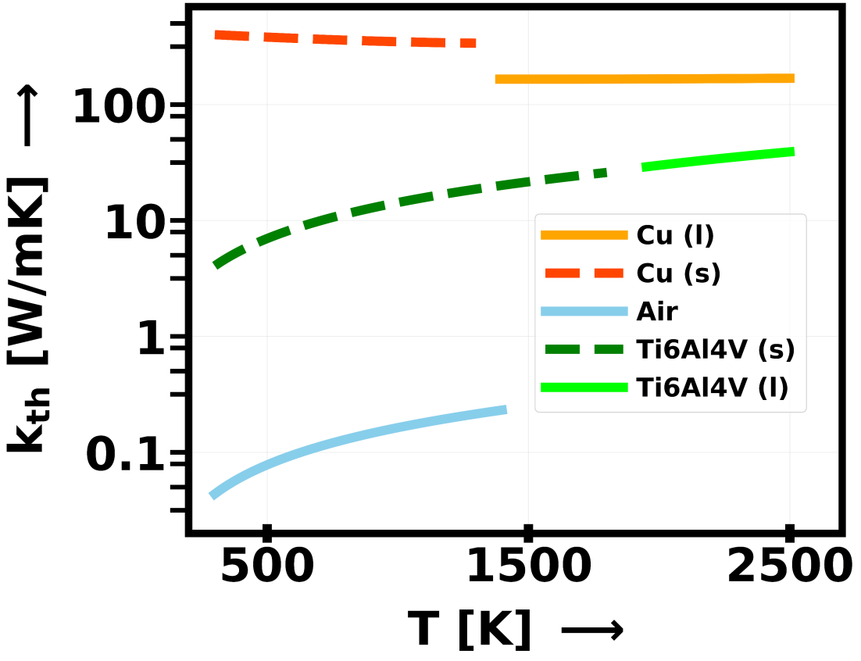
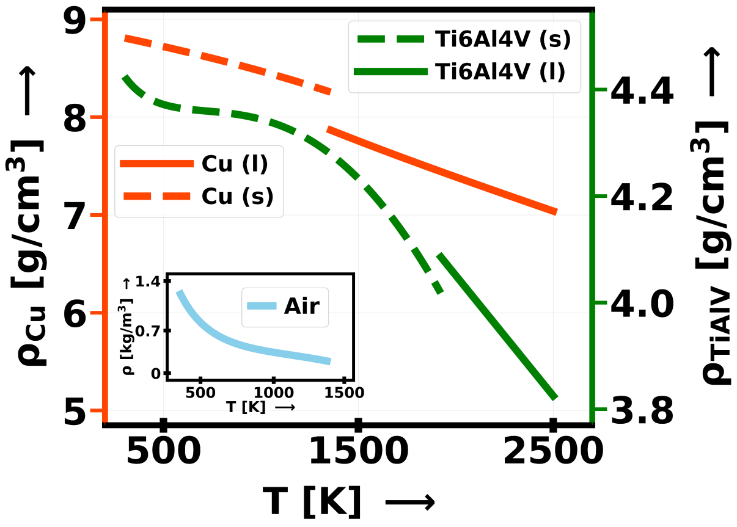
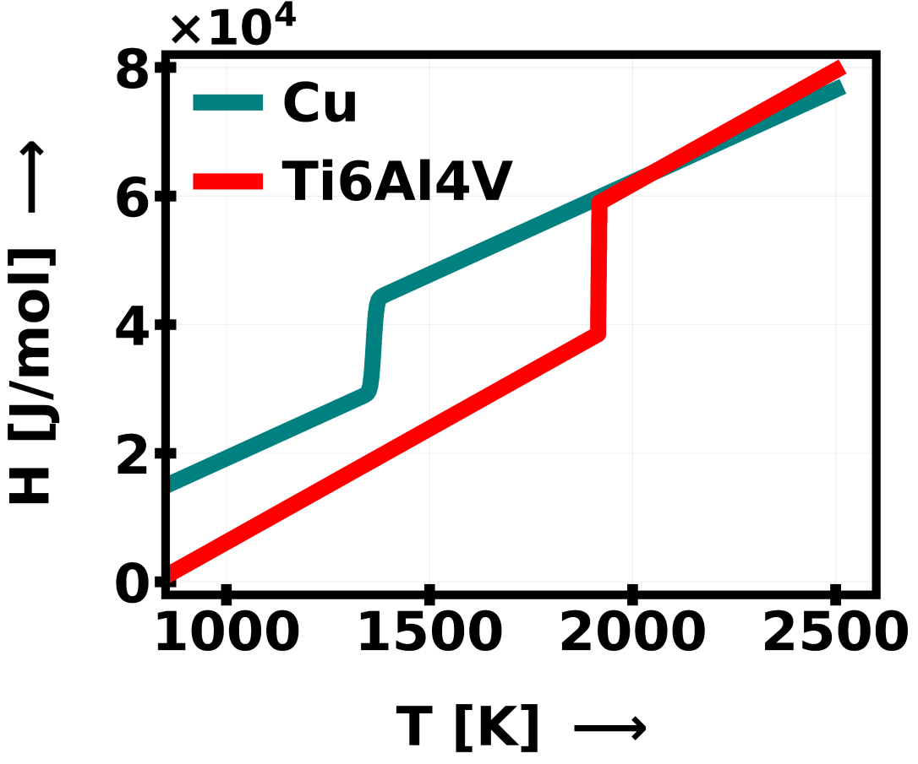
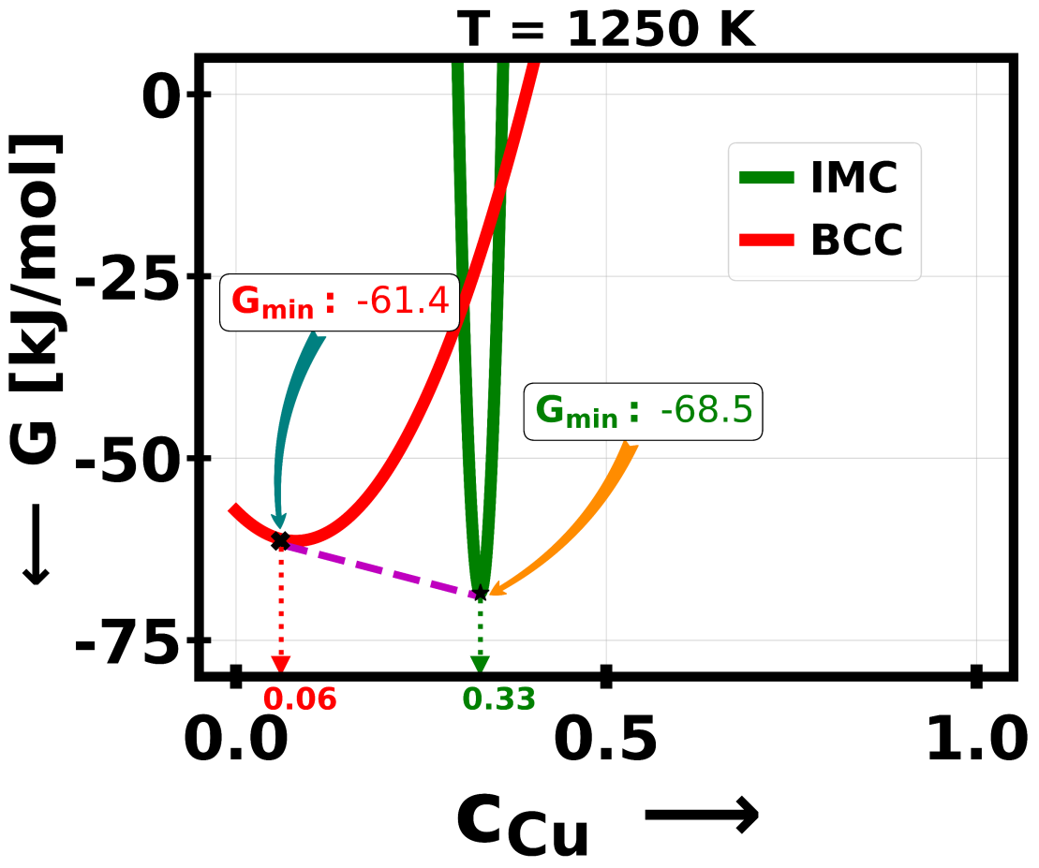
(a)
(b)
(c)
(d)

Slide 9
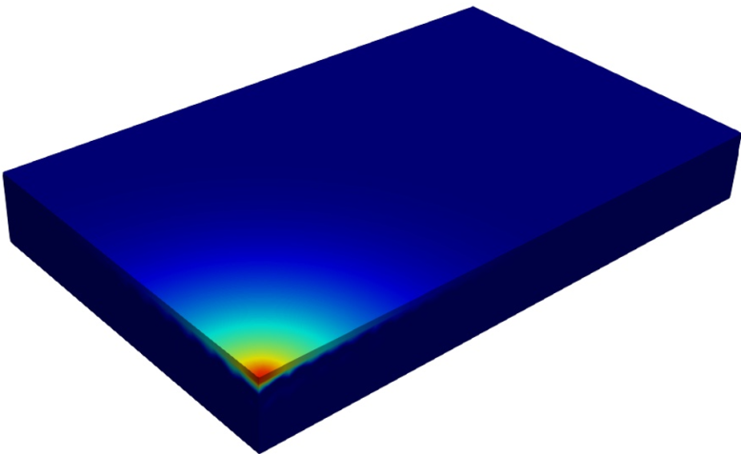
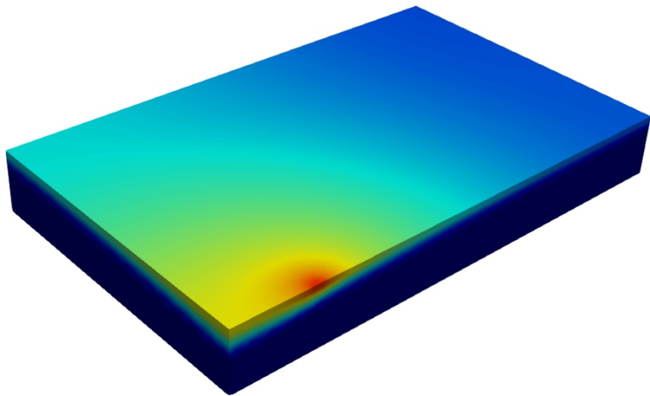
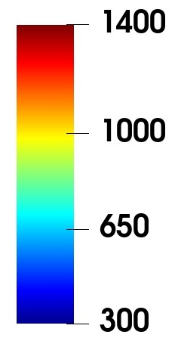
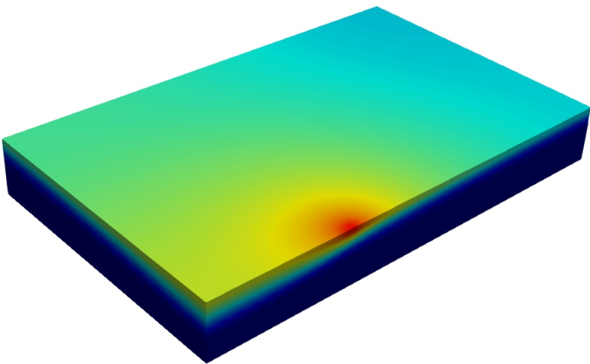
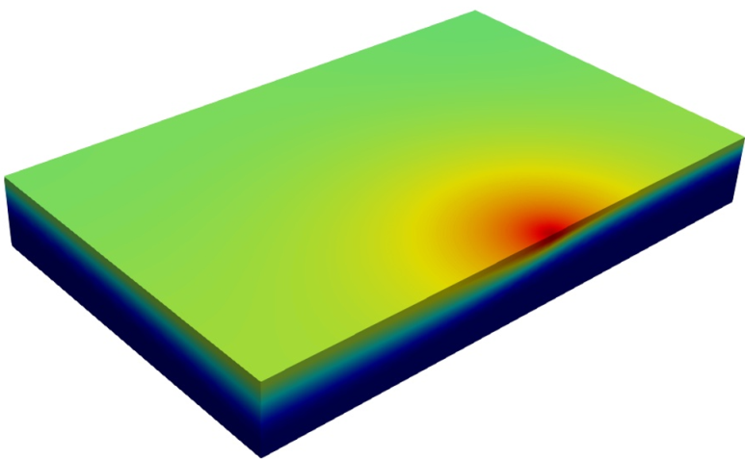
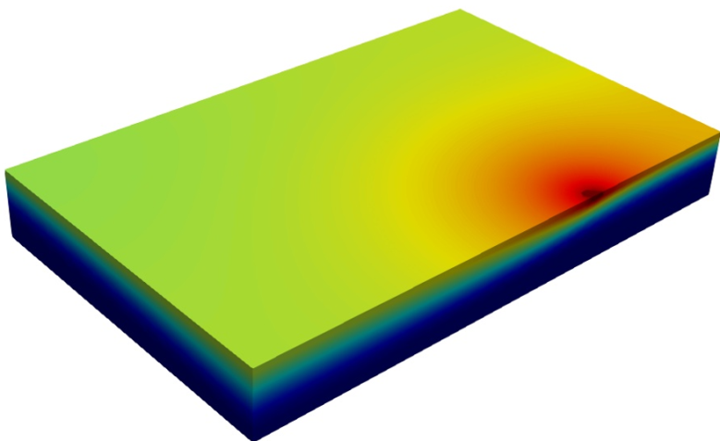
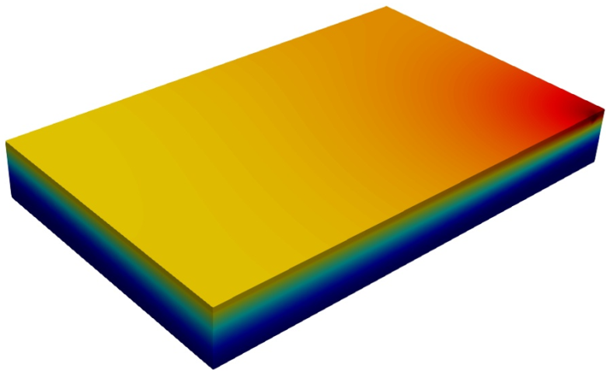
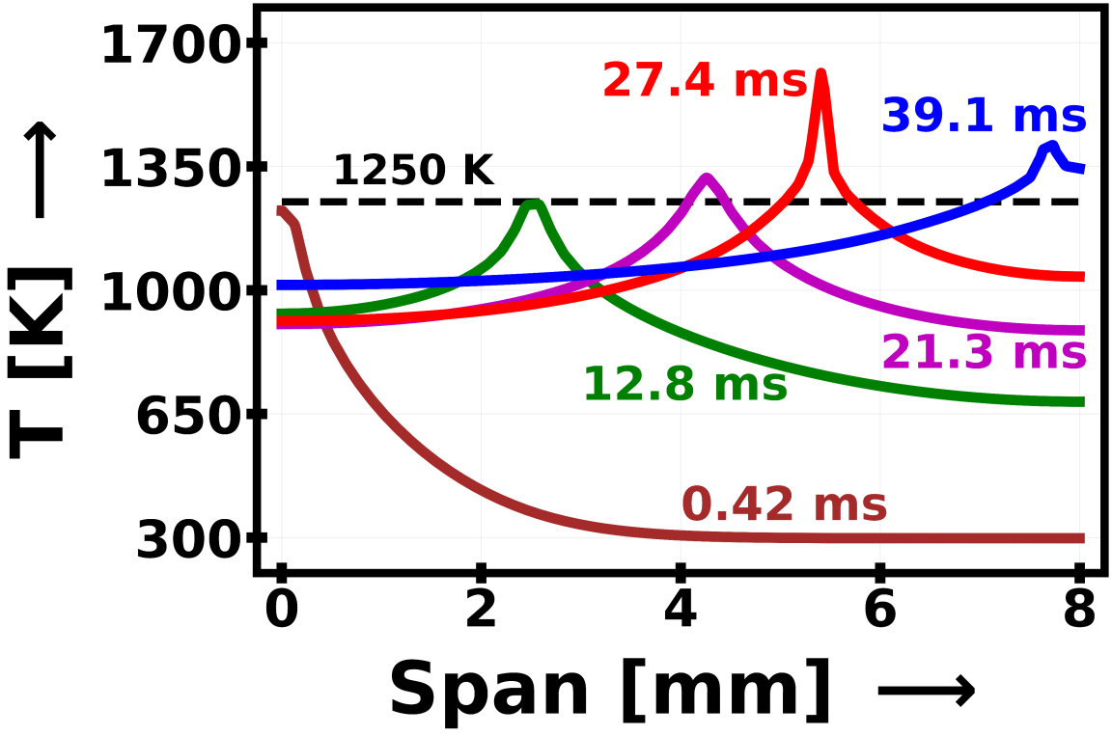
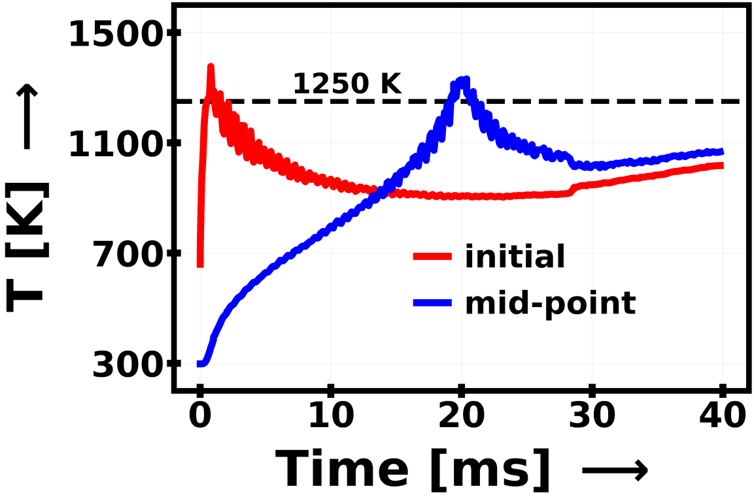
(a)
0.42 ms
6.84 ms
T [K]
12.8 ms
21.3 ms
27.4 ms
39.1 ms
(b)
(c)

Slide 10
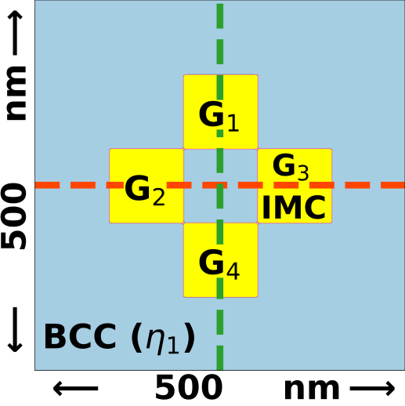
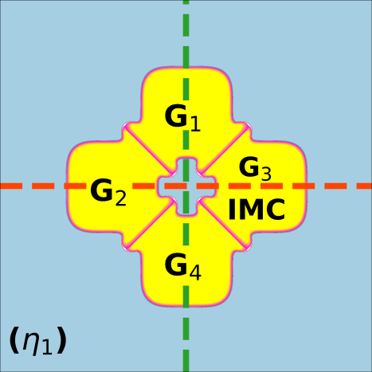
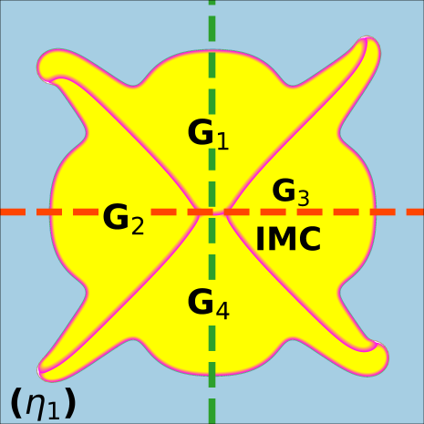
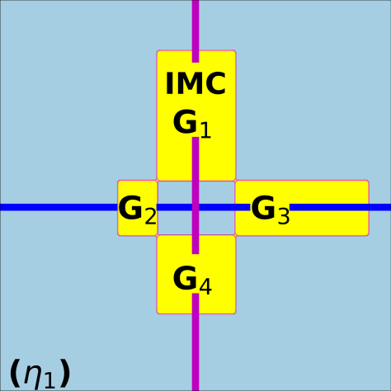
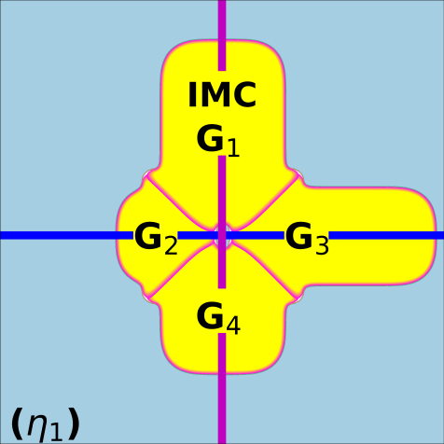
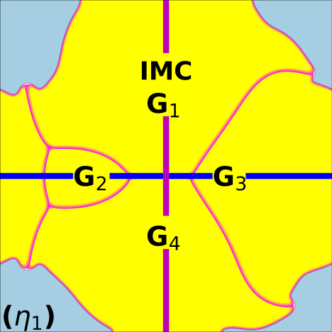
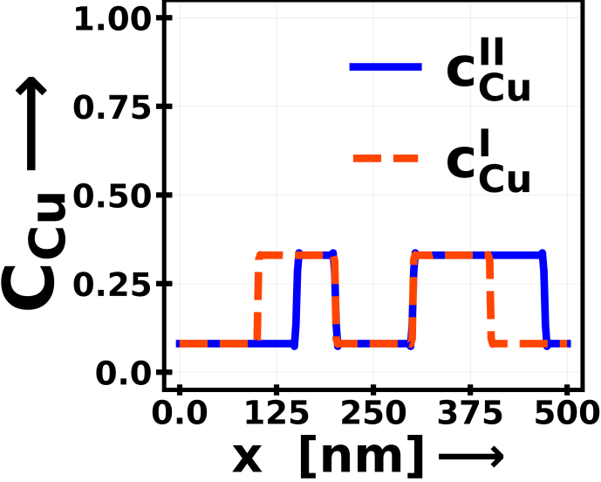
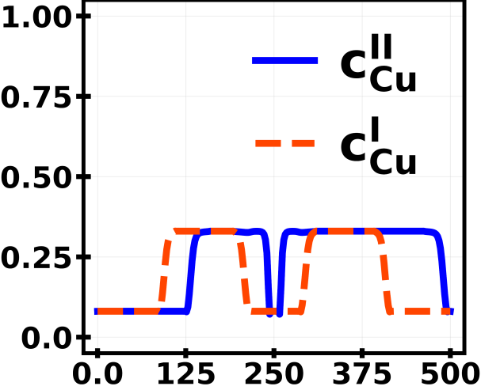
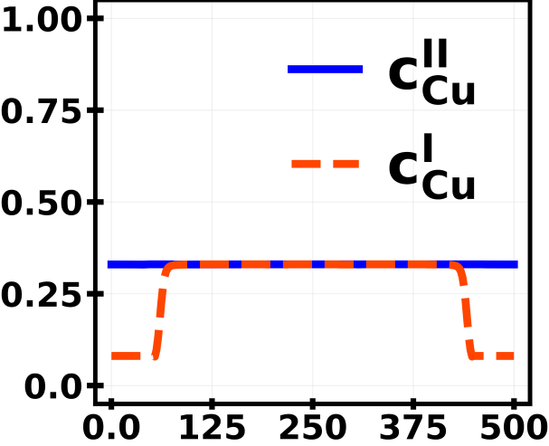
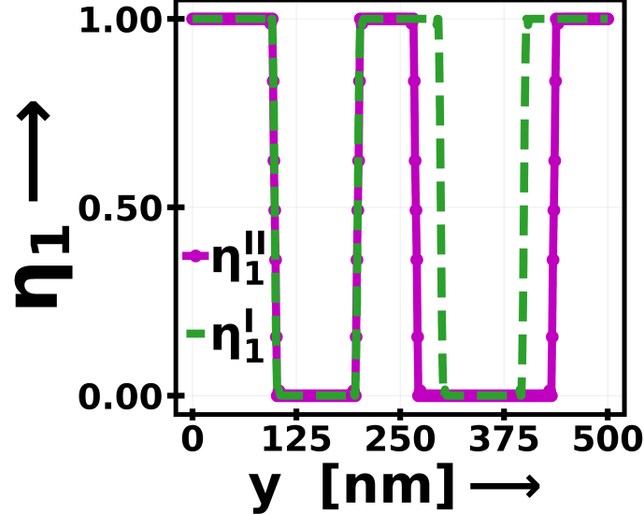
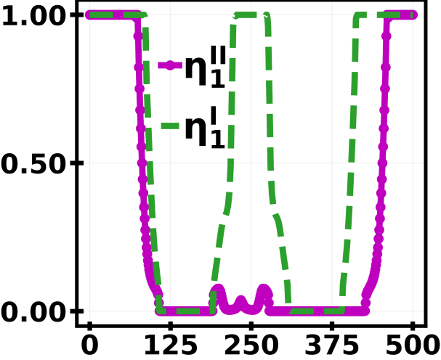
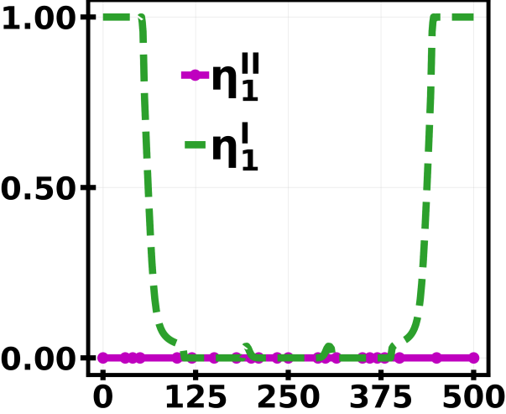
(a)
t=12ms
t=875ms
t=5000ms
(b)
y
x
(c)
(d)

Slide 11
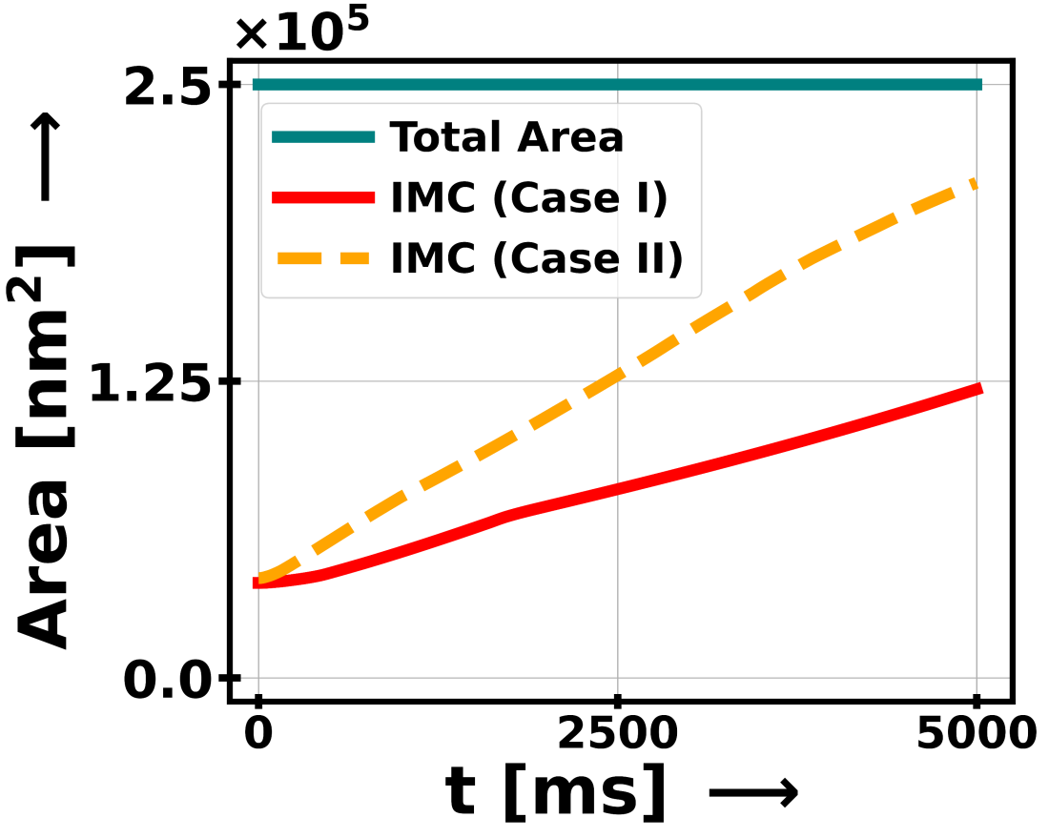

(a)
(b)

Slide 12






(a)
(b)
(c)
Alloyed layer
(d)
Lamellar structure
Precipitates
(ω-phase)
$$3μm$$
$$1μm$$

Slide 13






(a)
(b)
Ti-$α$
Ti-$β$
Ti₂Cu
Intensity [a.u]
2$θ$
(c)
Alloyed layer
(d)
Lamellar structure
Precipitates
(ω-phase)
$$3μm$$
$$1μm$$

Slide 14

(a)
(b)
20 µm
20 µm
(c)
200
150
Positive signals [% of pixels]
100
50
0
Ti6Al4V
Ti-Al-V-Cu

Slide 15











I_{max}=26.9 kW/mm²
HETEROGENEOUS
STRUCTURES
SUPER-GAUSSIAN
HEAT SOURCE
$${Ti}_{2}Cu$$
Vs=200mm/s
Microstructure
FEA
Cu powder bed
Laser Manufacturing
Ti6Al4V
t=5000ms
Anti-Bacteria
Phase – field simulation
INTERFACE
MODELING
BIOMATERIALS

Slide 16




Ti-$α$
(i) Ti-Al-V-Cu
Ti-$β$
Ti₂Cu
Intensity [a.u]
(ii) Ti6Al4V
(022)
(iii) Cu powder
(002)
(111)
20
40
60
80
100
2$θ$

Slide 17







Ti-$α$
Ti-$β$
Ti₂Cu
Intensity [a.u]
2$θ$
Ti-$α$
(i) Ti-Al-V-Cu
Ti-$β$
Ti₂Cu
Intensity [a.u]
(ii) Ti6Al4V
(022)
(iii) Cu powder
(002)
(111)
20
40
60
80
100
2$θ$

